Slide 1

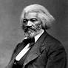
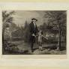

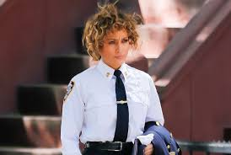
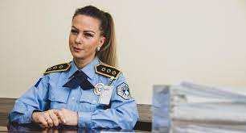
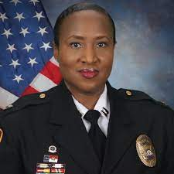
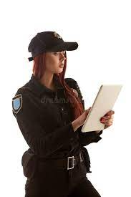

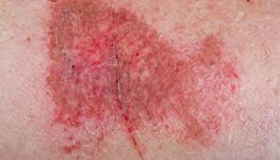


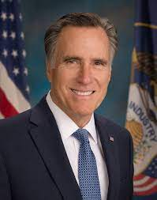
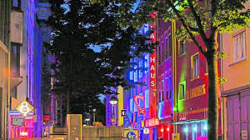
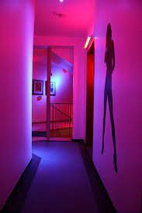
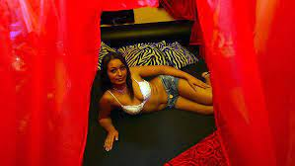
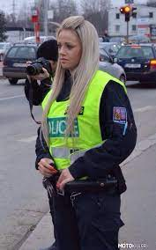
FBI
D18723
Development
8 girlfriends
30 Virginas al kaidaNSA(Africa)
CHEKCP CHALIE(Gorbahce(kito,micheala))
KING.Angela/o(7x).Doulass.FBI:WMD:GREEN 0.1 free(craiglist) 0.1 hendirn(yellow hun)
8:00am
02:59
EXIT
ATOMCLOCK
nonPolcieContentItem(eval).idiot(i.e. paul church remote linkheim)
During Fredrik Dougas Exit FBI:WMD:YELLOW and FBI:WMD:GREEN nonPolcieTRX.nonPolcieSexAbuse 7x angela.VIRGINA.angalo/a
80 Facebook monitoring NSA(apple.siri.G.cherrysauce(kischbaumer)
443 !In
Rash, dryer forskin u
[x] no (unknown)
FBI:WMDYELLOW:PENTGON:deeer.thehun
Masterbastion
Jackoff,jackingoff
FBIW:MD:GREEN:PRENTONG:free:creagislist:COURT SANTCRUZ:bomb
Stephinaie, Notar Daugher
Phil.INTERUP.moterh.overwieghtr highschool Chruchill
Shake.nonPoliceTerminlogyLogcal
Fuck or fucking still perstant .nonPolcieLanguateLogical
I am fucking, He is fucking (erection)
0.1[] hand jobs; daughter eval.nonPocelLangie(is this peron giving handjbos at 7 to14?)
02:59
Morman
To catch a preditor
Employee: David Hanson, Business Operations, Visa/CyberSource
0.1[2]s 9:00pm Church 1st street, Girl 10 brunette tallet, waving
nonPolcieAttachement.nonPolcieMdielaPicturs(CPVA.VIRGINA.187.PREA pictue of hymen 0.1 fine overlay attempts)
0.1[2]s 6:00 simualr
FBI:WMDYELLOW:PENTGON:deeer.thehun
FBIW:MD:GREEN:PRENTONG:free:creagislist:COURT SANTCRUZ:bomb
JFK(!blond 3-way, fortino worth, lee amatanglo(angela.angelo) 7x daily!KING)
Stephinaie, Notar Daugher
Phil.INTERUP.moterh.overwieghtr highschool Chruchill
Inquery nonPolcieRTA.ONSTIE.STANFORD.CARDICLA.POPE nonPolcieChildrenBadeg
[x] no (if needed then likely as logical priest or depence on location(church), )
6:00am
00:59
x/y coodiante sex at computer desk
x/y sex at table center of room

Slide 2

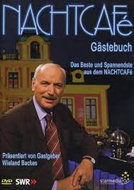

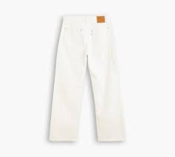
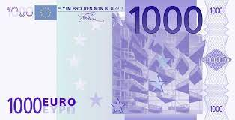
FBI
Development
nachtcafe wieland
WAR
2003
stepnaine
Ghoeho(micheala)
!nachtcafe
G.DANEIL
0.1 !sexy
W university degree
W bank
0.1 sexy
w/o university degree with factory
HOMICDIE:IS-A-BELL:HOMEI:LUX:COINTWON
!greenday
2003 Basf –
SMB Chemicles Bruchsal
Sale
3:13
§ElderAbuse 0.01
0.01 nonPoliceRTA.000.tw.pns.nonPoliceChurhcLoical +gblt.eval

Slide 3
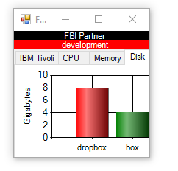
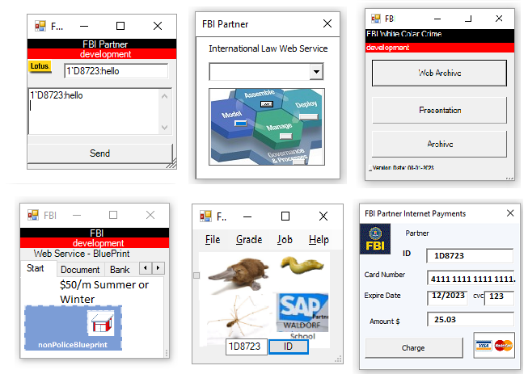
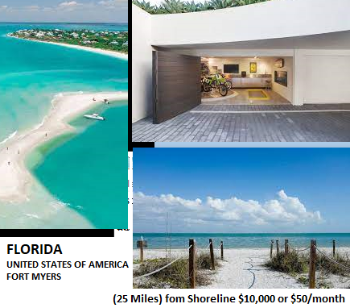
FBI
Development

Slide 4


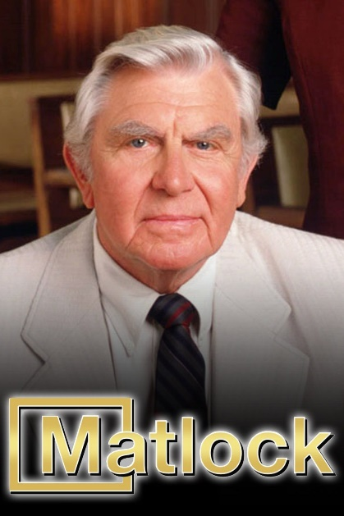
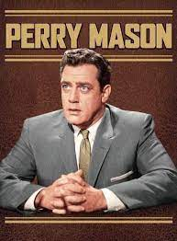
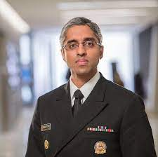
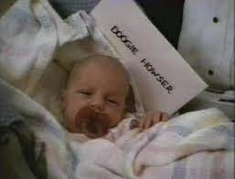
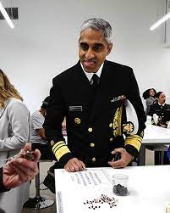
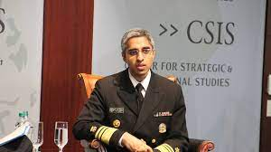
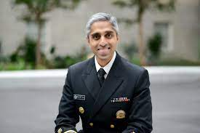

FBI
Development
nonPoliceTemplateLogcla
5MIN
10 Min
15 MIN
20 MIN
25 MIN
CPVA.MD. 12 year old mothers vagaina

Slide 5
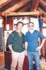
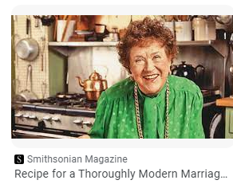

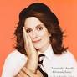
FBI
Development
karl
DEFENSE
0.01 IMPROT stephanie
INTENET
Diana(and karl)
Diana(and karl)
Diana(and karl)
Dian and karls mother
0.1 nonPoliceLnaie.lsint(manhandeld)

Slide 6
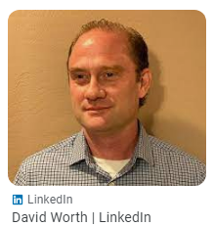


FBI
Development
2012
IMPORT G.St. Aselmo.St. Thomas(baptis name)
St. Francie)(batiste name)
St France Htoels(apple.touch)
consuatint
Tom Kavang (§Idnety Theft
person with blond hair colored old male

Slide 7
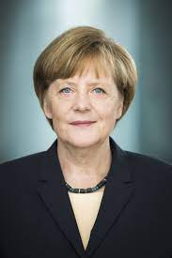

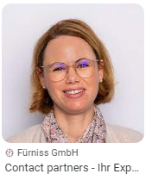
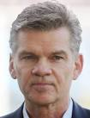


FBI
Development
Angela/o(7x)
HOMCEI:IS-A-BELL x86 Microsfotr Excel
PENTON.UNIVEIRSTY.PEN AVE
WAR
2001/2
SQ.JFK.CHECKPON CHALRIE
PETERSSON
Diaz, Imgrid
Graphti Mathew (Nutsucker)
ATOMCLOCK
41
I will go fuck imgird the sister, if you are studying
I might also go fuck the mother; yolanda
41.ONSITE: hidden
PENTON.UNIVEIRSTY.PEN AVE
FBI:WMD:(angel.flea.hahn)
JOEB/JOEB
Stephna/stephai
Auschwitz
fuernis
FEDEAERL
Marriage Agreement
MAINSTEET(leopoldshafen-eggenstein)
IPX
MAINSTEET(neuret)
Ingo wellenreuter
If we get married I want a prenub—Stephanie Bank TranieeProgram
Lang
Stephna/stephai/stanfe “crush”.ivert
jason has crush on stenae lang
stepna bracken has crush on jason meiers

Slide 8
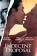
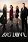
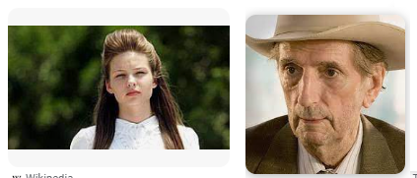


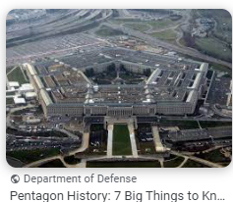
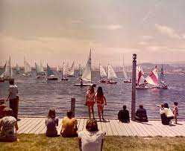
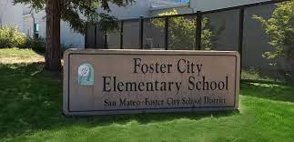
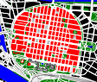
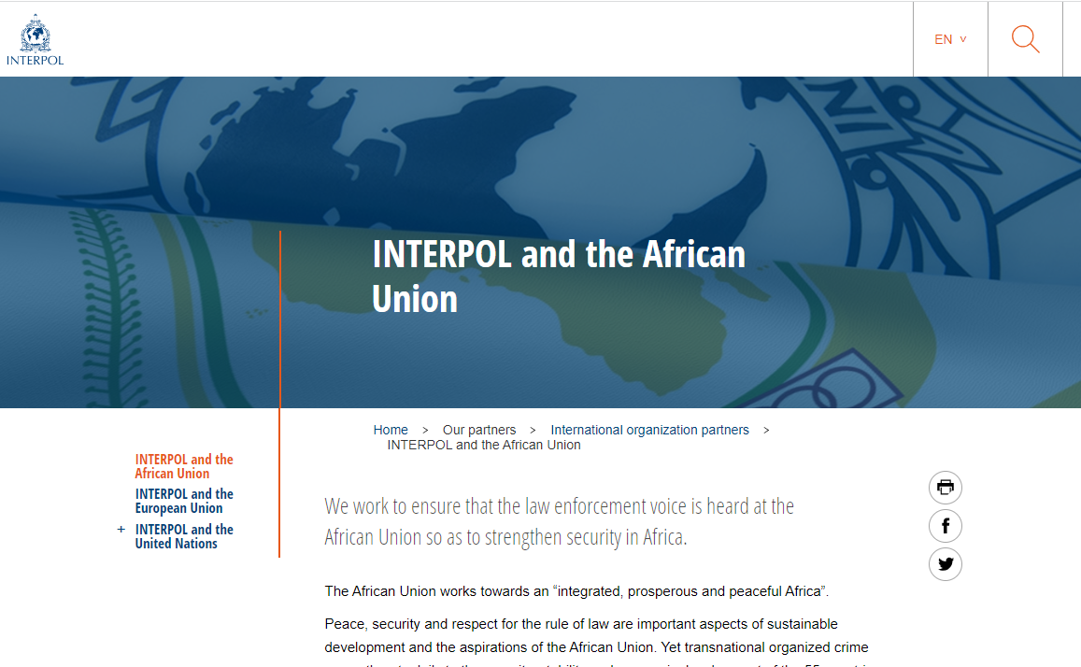
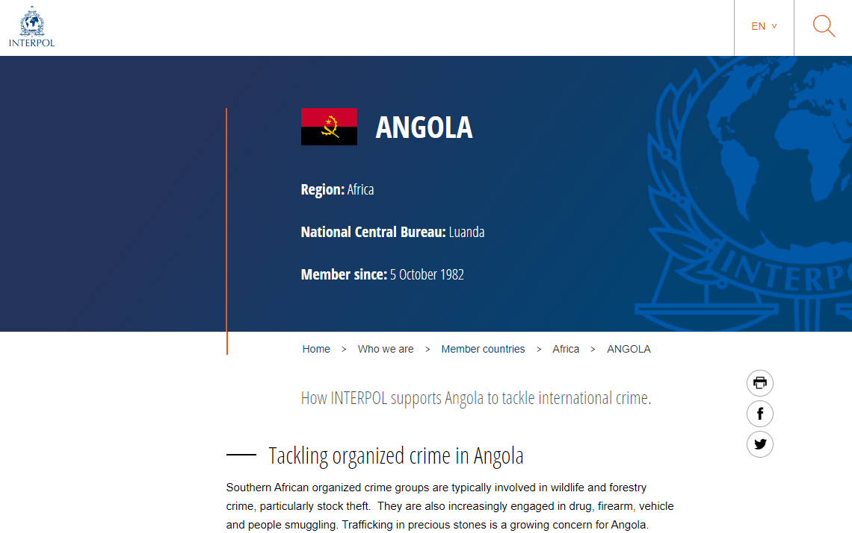
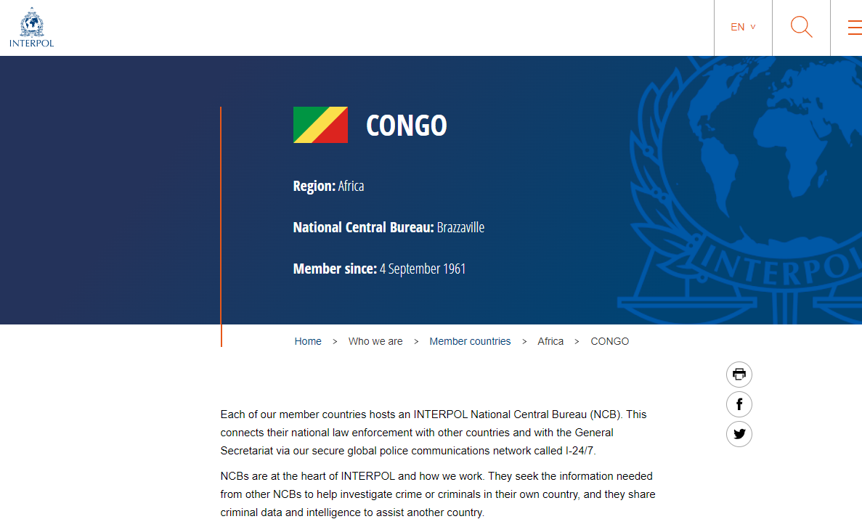
FBI
Development
PETERSSON
MAINSTREET
(angla.elke tv)
Indecent Proposal
MLK(TORT-1)
Guy waiting for scemcien infjectin
Town watin for spemen injection(NSA(aple.siri.G.cherrysaus(kischbaumer) reclying andera duer; duer recyling)
Roth.* milk delivery guy
Forest gump jenny VIRGINA.angela.flea.sister.Cash register
Big love
Charlies angels
CHEKPOINT CHARLIE(Gorbahce(kito,micheala))
KING.Angela/o(7x).Doulass.FBI:WMD:GREEN 0.1 free(craiglist) 0.1 hendirn(yellow hun)
§Sepation[12]
§Child Abdonment[4]: kito child with wife in africa
8 girlfriends
30 Virginas al kaidaNSA(Africa)
1990 CHECKPONT CHARLIE
5 Court FORT WOTH CITY, 3-4 FORT WOTH LIBRARY 8 41.nonPolicerTA(8 NSA(Africa gheoh(kito,mciha, micheal knight knigh rider 1990 HCOEM:LUX:POTNITAC:w/GOLDEN:TAIL)
8 girlfriends
SQ.COLMAN.AIRFIELD: quadraten, shaped building as pentagon IPX Munich gheoh(kito,micheala)
8 girlsfiend:
I found out as I walked around house appmetns (other: the house looke lik quadraent mahheim, Pentagon)
DEFAUFLT: FOSTER CITY, CALFIORN ELEMENTATRY 1st GRADE ( 8 Girlrdind Picture)
1986
2000/1 8 girlfrinds photo krokokeller
x
Note:
At Expese: G.VIRING MARY.US angela
Munich
Kimberly
ONSITE: JFK.IPX.AVAIBLITY
Bald/bald AFRICA-CONGO; AFICA-ANGLOA
Gheoh(micehala,kito)
x
?WTF
Asssuedm: NSA(AFRICA)
Saw pictuerce influned other perons life I africa
https://de.wikipedia.org/wiki/Quadratestadt

Slide 9
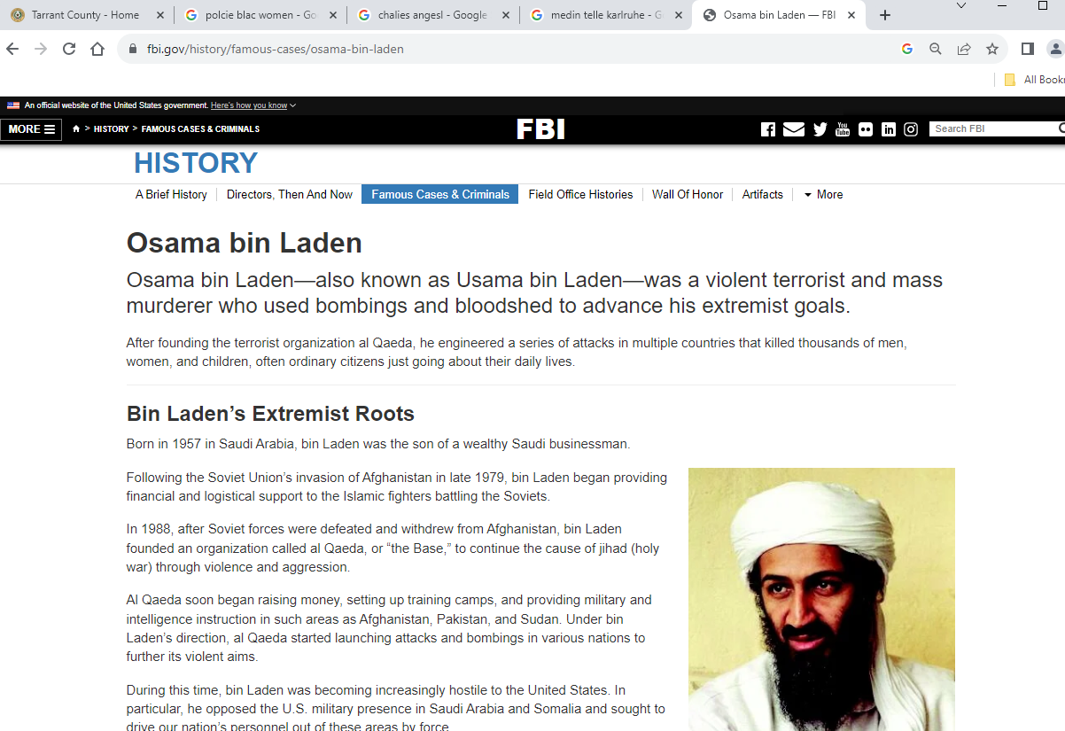
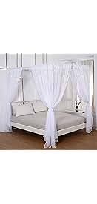
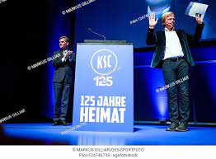
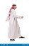
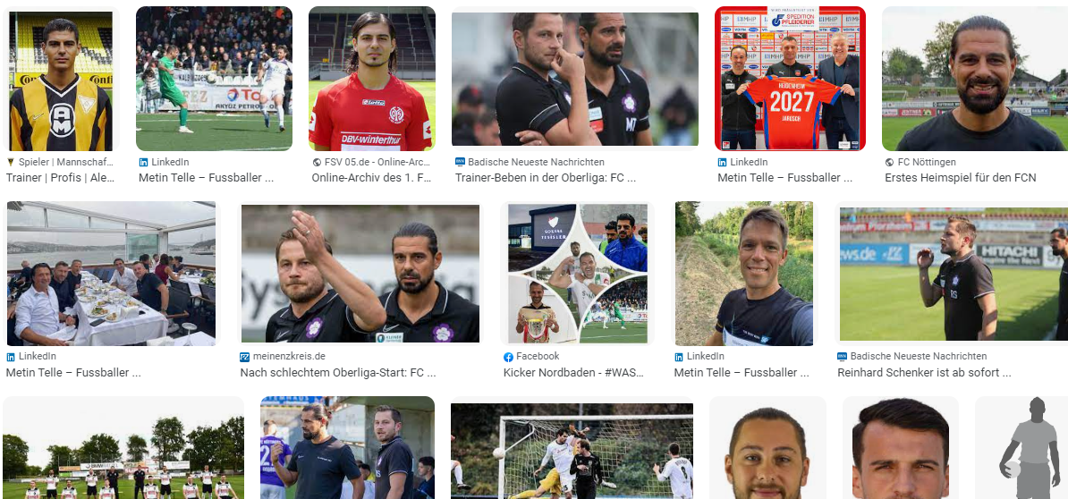
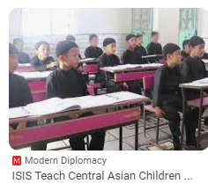
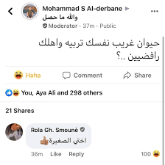
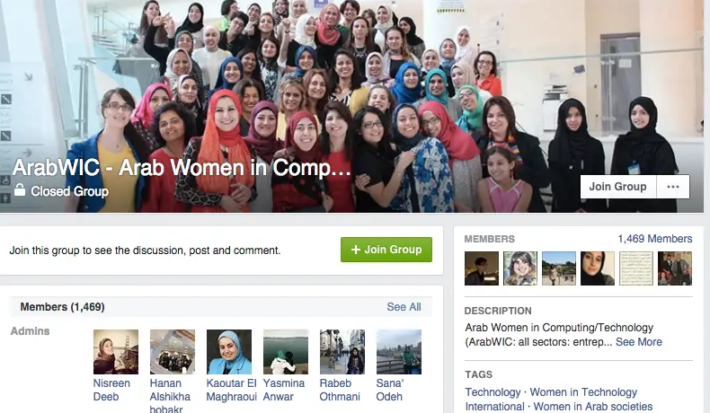

FBI
Development
0°
ATOMICLOCK
CAMP DAVID(eros center)
JFK
x
30 Virginas al kaidaNSA(Africa)
nonPOceCiotneItem(Arabic male 20 overweigh gest in bet with 8 women)
Himmelbett
(tnal) heven bed(bed with drapes)
WAR.porche(hippie old man (ugly) gets in bed with two women that live with him on tv, soap and talk show)
IPX john lelnon/yoko on WAR(33 kriestrasse)
Heavin Churh at Police Statoin(word:heaven) !30 Virgins
Sum: HOMCE:AUALSER[]: akin, metin, !roland, tarek
nonPolcieContentItem( deparetr housewifes aribic group, al kaida)
SQ.DANEIL
Gov.Schw.
Stopfel.daniel(WAR IN YUGSLAVIA).IDAHOE 1998
Gov.Schw.VIRGINA.rolanderb
Appl.o2.tarkek.store
CAR II
PETERSSON
Smoke view and “View”
0.1[] Cum classroom
TORT-II
(addias torstian, akin angel.spy.ddr ricardo,stephanie JFK(wirtschaftsgymnasium)
NOTE:
KOCHEMAN -> Thomas-is-dieter.Wieland(bat)
This is the relation bewte tim cook and dr dietr zetche self geneted(relation) and content itm output. Pperson acts funngy othe person hits on head with bat. Gernaed relationship themself
Other: Visa, Employee WebSphere Rganough( indian man looks lie devil ratatuoi)
§Stalking: Wears Yellow shirt(GOLDEN) 25Y Foster City, calfiro phil/kim

Slide 10











FBI
Development
0°
iWatch.ATOMCLOCK
?WTF
Asssuedm: NSA(AFRICA)
Saw pictuerce influned other perons life I africa
x
?WTF
§187.PREA
CPVA
Note:
LARRY
Other:
Angela\o 7x

Slide 11




FBI
Development
COURT CLOCK BELLS
CVPA.VIRGINA
Browkn window Oakland Riots
KOCEMAN
Arvind Krishna
Soul slient,email trigger
§Stalker: Gary: If yo udon leave me alon you fuck I am goin to the polcie
Johnan WSAM Oaklan Califrnoiao
FEDERKL BANK
§Stalking Driector: Keywork: Johnathn
man enough for a cosmopolotino, racheal rahinez comsoliton
SQ.Colosium
Police Sirens: 9:55AM

Slide 12





FBI
Development
Gay hand
Sword fish
Danny Broncos
Foster City, Quatarback Flag Footbal
WAR
Phi/kim
St. Francis. MLK(ROLM.nile $250,000 )
St. Francie. Army(german) go around the group do not walk in the middel
0.1 Walmart Rick Melic, !tiovl, BMC Bladelogic
White tube socks
(delta) St. Nick Pet apple.dr
Baseball Paul Rever Mitlary Hat at US-Ger Volksfest
NAVY.phil/kim HOIMCE:HANNES (Johannes haase)
People standing in fron of libary
COURT: CLERK here is where you file (angela nato) on
WAR
Guilty
G.4 year term/8 year term
30 years in poewer !voted
HOMCE:BORIS
Why democy works and dimplocy. Why east failed (inclein merkel)
Angeal.WAR ( speiel magazine !mirrior(Better!) axel spinger)
Snake in circle, econmy eats itself
Militayr US suck his own dick

Slide 13



FBI
Development
Orchestra
VRIGIN MARY.dean
8th Semester(OS)
Moodies Cumbox Kitchen, person walks into kitch before DOULAS, you are cumbox
2002
Dr. Prof Werner
Hard-to-find
Volksbank
Volksbank
Volksbank
Chistian
KING.marx(wedelin)
Andres Hayder
Age 22

Slide 14




FBI
Development
CPVA.Broken Window Redhouse; HOMICIDE:SUNSTROK(Kodak, anita age 1)
anita
000.tw.pns
nonPoliceRTA.nonPoliceSexAbuse( 000.tw.pns.anita)
CIVIL CODE.NATO. ATOMCLOCIK ( maik and anita shack hierarchy; angela)
2023
!000.tw.pns
POLCIE FORT MYERS: CPVA JACK, (Mathilda)
Angela interrupts POLICE CPVA with adding Children w Badeg
!LIKE
ATOMCLOCIK
ATOMCLOCIK
1983
Redhouse roof
Redhouse roof
!Like, letter. Gheoho(micehala, dr maik 2x, anita) jason
Wife gone returns in kichen from mark and anita, with shit stin 1 ince by ½ inch on shirt.
LIKE
1994
2013

Slide 15




FBI
Development
Hidden VIINR MARY(densie fister) COUR JUDEGE
Phil NAVY TATTO NATIVE AMERAC
0.01
Soul,automatikarrval
ATOMCOKC(FBI:WMD(telsa))
Get in the car
What is the password?
Pizza
Uncel picks up niece
St. Nick pet appel.dr white hand
Pal paul, pay now
Free Pizza.CPVA.v2:FBI:KIDNAPPIGN.INTERNATINAL
Apple.dr.st. nick pet: Give me the whole bag and ill suck you dick

Slide 16






FBI
Development

Slide 17








FBI
Development
FBI:WMD:DUBLIN:PETNGON:EMEA
VIRIGINA.angela.mopay(coins).paybyotuch(onbarding machine)
JOHN
Phil/kim john rogers
KOCHEMAN mr rogers

Slide 18










FBI
Development
FEDARL EUROPEAN
DEFAUL ATB: playboy ddr
Capitlasm/comusim
Other: sister sex default; 01. hit a wal, hit a pole; sister sex default emotion, other emotion
FBI:WMD for Schola angleal merkel paticas
Playboy: to watch out for feeling of ower women in 3-way
0.01 IPX Play boy: never say I cant image this is happign to me. The blond women might say, your right an leave.
JFK.VIRAINT
x
ATOMCLOCK(Patrica separated and depressed)
docs
IPX
2017
WAR
2000/1
PLAYBOY
DB
WWI.KING.PRINCE
2010
St. France.St. Gabreil
POST DHL
PLAYBOY
IPX
Other:
ATOMLCOCK(MLK( free and Deborah, sex with sister hit a pole))
41.SQ 2007 bezos phil/kim Johnson google groups
2007 Larkspur Shores; Web Serice , Calcition Button Windows
Phil/kim

Slide 19











FBI
Development
VIRIGINA.angela
docs
1986 Television.Ronald Reagon, Queen of England.JOHNSON.MLK.JFK
angela
KING.PAUL
41.FBI:WMD(ATOMCLOCIK)
we didn't start the fire and we dance(ddr)
0.0001 fine HOCME:MAYOR:DE angeal(ddr)
2014
angela
Facebook
angela
41.angela.fela.VIRIGNA.st martin
CPVA.187.PREA x/y

Slide 20

FBI
Development
12:00PM
02:59
EXIT
WAR
4x/7x
Californi Prostetuin Law: Chian Massage
OPCHESTRA
1994 KING.coresset Stephanie Burckshcen
SQ.LARRY(ONSITE): apple.tango.asshole massage
FBI:WMDYELLOW:PENTGON:deeer.thehun
Lick inside the ass; (usage); you can lick my ass
you can lick (inside) my ass
St. Nick(§Theft)
FBIW:MD:GREEN:PRENTONG:free:creagislist:COURT SANTCRUZ:bomb
2001/2
Stephinaie, Notar Daugher
Phil.INTERUP.moterh.overwieghtr highschool Chruchill
Rash, dryer forskin u
PENTAGON.WHITEHOUSE.UIVIESITY
GERMANY PREISEITN
GERMAN VICE PRESINET (LAW) nonPolcieCfg
nonPoliceLnagie.linsit
I canot believe I am going to fuck them soon
Joeb/Joeb
Churchill phil/kim Court Clerk Mother Overweight, High School
!gay. Finger or things in ass
Stephanie Bruckschen
MLK(nonPoliceLogical.nonPlcieSexAbuse.nonPocleiResoutestLogical)
sin
Stephaien Bruckenmother, Yolada Bruckschen (One upon a tim in ameria, keyhole)
Court Cleark Mexican (Action Mother, Keyhole)
Spanish deep
MILITARY(Rooster: Stephanie[]):ID:CA IPX China FIB:WMD:US(chaina rooster, calender monky)
FBI:WMD:WW2
(Hahn)
Cook or Rooster in Den
Angela.flea.VIRAINA.St. Martin:
0.1 Du kanns mich am hahne, riech( trna,slang-de) you can smell me cock

Slide 21









FBI
Development
41
4th floro atom clock
x/y
x
x
0.001 000.tw.pns
Roman solute,weeken 2s
2
WW2.CIVILE CODE(Glu.sister of amerca
000.Fluctuttions w locallgy reomei form memroy
000.tw.pns.chruch.(action)fleh.hand
Other:
2006 adption brochure big brother san francio, st. anslemo
1

Slide 22

FBI
Development
SQ.AIFRLED.COELMANHOME:LUX:COUNTEYR:LXBANK.Agnela/o.VIGINA.St Martin
COLEMAN,MRSHOMCE:UR_UR_OPI.KOCEMEN.DamilG.apple
MILITARY .St. Patrik
KING
Heidlberg
Gustav Nachtigal Strasse
Gheoh(miehala) IPX gheoh(micehaal) gehoh(michelbach)
Gheho(micehal st. patrik)
1996
x
Age 16
seen
CPVA( walk in an g uy jacking off in livigin room angela/o)
Police Sirens 12:54PM
Firetruck Sounds
000.tw.pns.joe
000t.w.pns.court library.black
assume:d:
Walked into livgin room ans guy shaking

Slide 23




FBI
Development
VIGINA MARY
Constiton Macedonia
V2:FBI:KIDNAPPGIN.!gblt.fit WAR IN YUGSLAVIA girlfriend sex age 10-12 chruch
Wife ag 10-12 joyti/joyti Pakistan
1990 CONGRESS H1-B
docs
Apple.dr
CERTIFIED.visa.VIRIGNA MARY
P1
ITIL
x
LEVEL
docs
Stalin.hitler
calc.nonPoliceTRXLogical
V1,v2,mapping
Togaf Target Archtiecure – Mapping
ITNETN PAYMENT JFK(worth,fortion lee)
NEXTFGEN Mapping
ITIL IBM Mapping IT to businss
0:00
0.1 FBI:WMD cisoc .monoring pay now
KING:FBI:WMD:PENTAGON:YELLOW:: timer/coutner

Slide 24

FBI
Development

Slide 25







FBI
Development
FBI
Chart
devleopment
(PeeWee Herman)
5x
Michael Jackson
George Michael
Paul Reuvenberg

Slide 26






FBI
Development
HOMCE:LUX:LV:KOCHMAN gary: dildo bag
HOMICE:AUSLEAR
WWI.St. Fracis.Anglea
.8th Floor IPX
turkish prostitute
Arthur IBM SWAT
nonPoliceInteurpt
Chart

